Slide 1
DATABASE FOR BANK
Alibek Kadyrkulov, SE-2016

Slide 2
Outline
1
1
INTRODUCTION
2
DEFINITION
3
OBJECTIVES
4
BENEFIT
5
CONCLUSION

Slide 3

INTRODUCTION
In order to manage an empire for instance, even the earliest ones, some form of banking was required to manage trade and keep the flow of goods and services moving both within the empire and to other empires.
Once currency emerged, this made this exchange of value much easier and efficient, and now one could simply trade things like coins or gold for other goods.
The bank has become the main tool at the moment.
2

Slide 4

DEFINITION
BANK-an organization where people and businessescan invest or borrow money, change it to foreign money.
DATABASE- electronic database, any collection of data, or information, that is specially organized for rapid search and retrieval by a computer.
3

Slide 5

OBJECTIVES
PROJECT PURPOSE IS TO CREATE A DATABASE FOR THE BANK TO STRUCTURE THE DATA FOR FAST ACCESS.
4

Slide 6




02
FINAL RESULT
01
03
FINDING INFORMATION
DRAFTS
FINAL RESULT
9-11-2020 to 12-11-2020
13-11-2020 to 17-11-2020
20-11-2020
TESTING PILOT VERSION
18-11-2020 to 19-11-2020
5

Slide 7
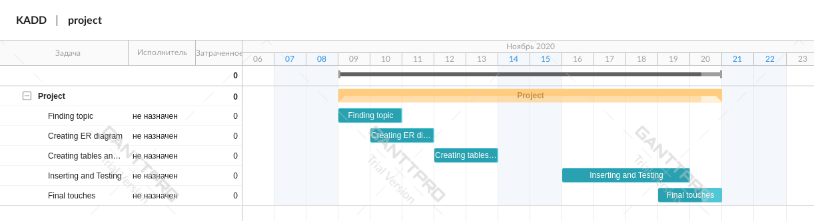
Gantt Chart
5.1

Slide 8
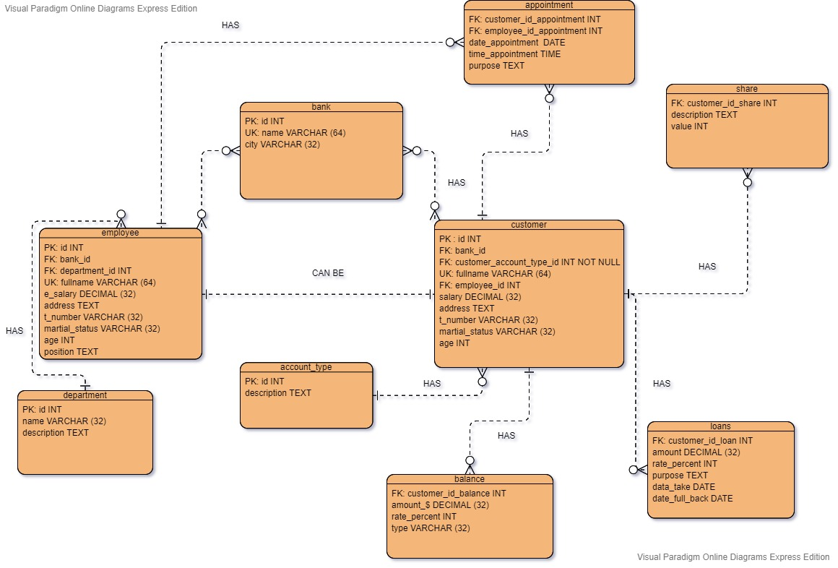
ER diagram
6

Slide 9

BENEFIT
Broad knowledge of the database.
Understanding of the banking system.
New acquaintances.
The ability to create an action plan.
7

Slide 10

CONCLUSION
Project creation and implementation helps to develop personal qualities and broadens your mind.
8

Slide 11
REFERENCES
9
HistoryWorld(2020), History of Banking http://www.historyworld.net/wrldhis/plaintexthistories.asp?historyid=ac19#ixzz6eOxMZsG4

Slide 12
Thank you for your attention!

